Slide 1
PRODUCTION DETAIL
Production House : GEF SGP Indonesia- Terasmitra – Motion Capture
Original Title : Sejengkal
International Title : A Little Twist
Running Time : 38.38.05 Minutes
Production Year : 2021
Director : Arie Oramahi
Country : Indonesia
Language : Bahasa Indonesia
Subtitle : English
Screening Format : Apple Prores
DCP
MOV H264
MP4

Slide 2
LOGLINE
a story of a strained relationship between a son and a father in breaking the gender stigma.

Slide 3
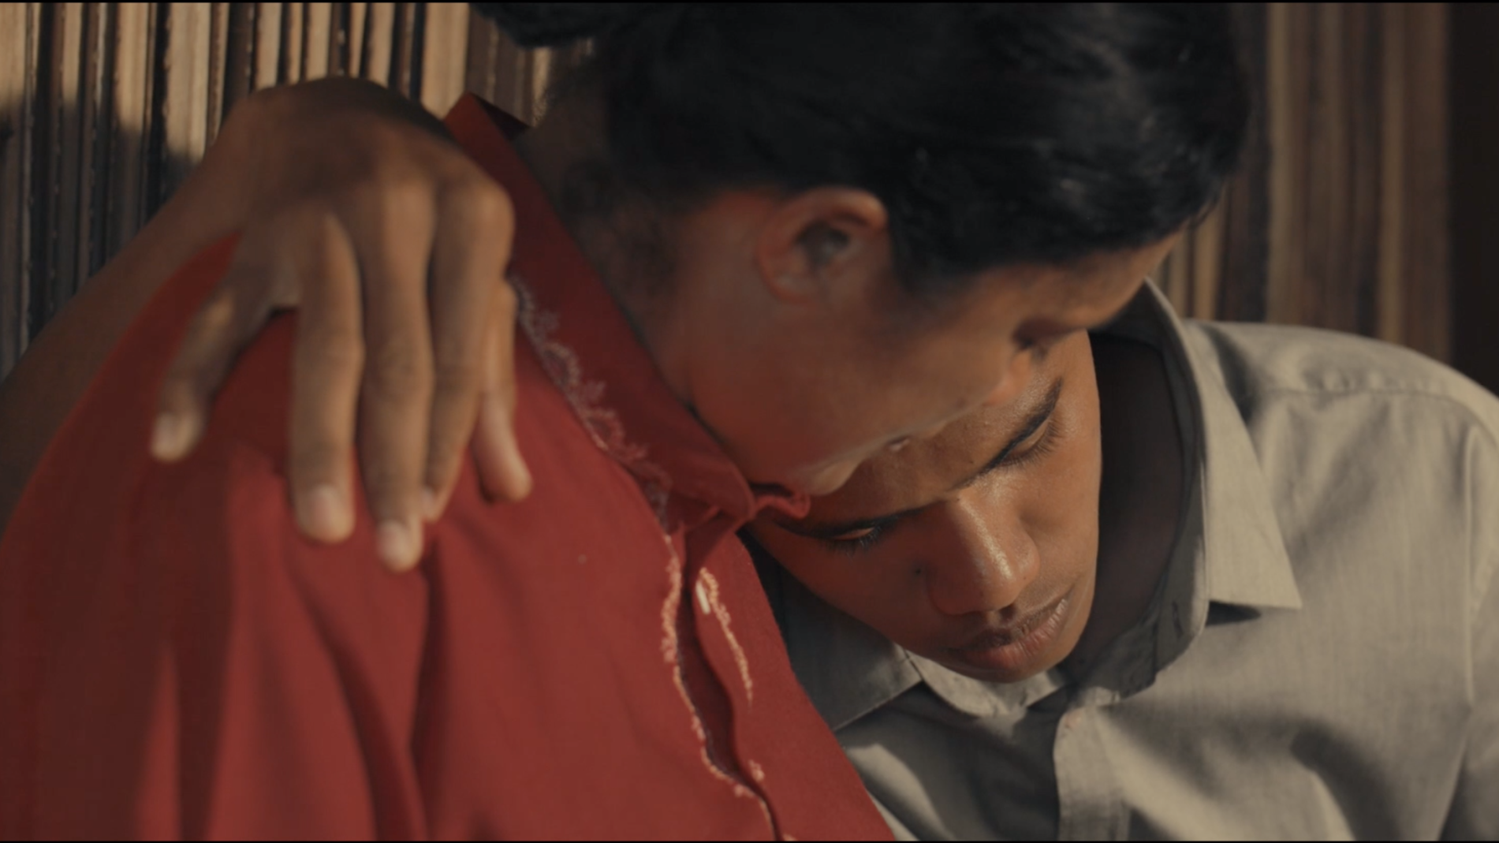
SYNOPSIS
The story of MENAS in challenging the stigma of gender discrimination within the weaving culture in the eastern part of Indonesia. His love for his late mother puts him against his own father, a loyal supporter of the tradition inherited by many generations before in his motherland.

Slide 4
DIRECTOR’S STATEMENT
Local wisdom usually consists of cultural values and humanism, which often creates a phenomenon or even a stigma. Just like the generational assumptions that weaving is taboo for men amongst the people in Semau island, East Nusa Tenggara, Indonesia. Men-weavers are being questioned regarding their manhood, and they face the risk of being outcasted.
Since the first time I heard about the story, this phenomenon really challenged me. I think the idea needs to be delivered to many people. In a fictitious story, MENAS, the only son of Mama ESTER and Mr. ALFRED, struggles to finish his mother's woven cloth. Mama ESTER had felt that her time in this world is nearly over, that's why she prepared the cloth to cover her body later. This story becomes the vehicle to deliver how the phenomenon had impacted the cultural and social structure in Semau island.
This film is not subjected as a critic to the long-standing culture on the island. I just hope that the film can be accepted as a love letter to the beautiful island in eastern Indonesia and the people who accepted me as their own, allowing me to create and tell the story.
Arie Oramahi

Slide 5
EXECUTIVE PRODUCER’S STATEMENT
Sejengkal, A Little Twist is not an ordinary short film. It is filled with symbols of people's lives in the eastern part of Indonesia. In 30 minutes, we are invited to experience the way people manage the natural resources along with the challenges.
Manu symbolizes the stereotype that people put on men-weavers, causing him to be an outcast. On the other hand, Menas, a boy who really loves his mother, is the symbol of resistance to the social stigma and stereotypes in society. Both are brought together by the woven cloth.
Through the woven cloth, the story flows. The process of natural dye becomes the symbol of how chromatic human's lives are, driven by their colorful intentions. In creating varieties of colors, a weaver will put all his heart and soul. The Semau weave in this film exists not only as the product of local culture but also as the vehicle to bridge all characters and tell their stories. It is also used by the characters to fight against the local social stigma.
In short, this story is not a heroic, nor patronizing story. It's a story about humans, nature, and the connection between them. I am so proud to be part of it.
Catharina Dwihastarini

Slide 6
PRODUCER’S STATEMENT
Injustice. That might be the right word that inspired this story. The injustice that's built by the notion within the society, that men will be dubbed as a "miss" or "sissy" when they weave because weaving is a woman thing. Supposedly, people need to be aware that preserving traditional culture, which has been corrupted by unstoppable modernization and capitalism, is a joint effort between all genders. It's not the time to see work as men's or women's anymore. Today, men feel necessary to preserve culture, even though it is odd to their community, for the sake of preserving woven cloth.
Just like what happens in Semau island, Kupang, East Nusa Tenggara, the young people are not interested in learning to weave on top of the stigma that men weavers are not men. Weaving is taboo for men. This is the base of Sejengkal, the story of a boy's struggle in finishing his late mother's woven cloth, opposed by his own father.
It is a unique and interesting experience in making this film since 80% of the crews are Kupang and Semau locals. All of them worked hard to finish this film. Hopefully, this film can be a reflection for us to understand that a generational value in a society has a two-sided coin effect. When one side faces up, the other side must be facing down.
Also, hopefully, this film can encourage the young people in Indonesia to continue preserving the traditional heritage of Indonesian culture without gender discrimination.
Robertus Wahyu Dewanto

Slide 7
Production of Sejengkal | A Little Twist is a collaboration works between GEF SGP Indonesia with Terasmitra and Motion Capture
There are many interesting stories found by GEF SGP Indonesia and Terasmitra while assisting community-based social entrepreneurs. These communities strive to face economic as well as natural challenges. They design their own stories in facing these challenges, with their own way, their own narration, within their own culture. Yet their stories are told only through conventional media, such as books and reports.
Catharina Dwihastarini was the brave one who transformed these stories into a new media, a film. It was based on her love for the important role of humans in taking care of nature, and the challenges they face because they act differently than what's normal in society, which not many pay attention to. It's the same spirit that exposed her to people like Manu and Menas in real life. They are marginalized people who act differently than most people. They are those who understand how to position themselves and act simply in protecting nature (depicted through weaving) even though their work is ignored because of the stereotype people put on them. Inspired by these real people, this film was made. The challenge emerged when compositing the script since we want the viewers to feel the struggle in preserving nature while facing the social stigma. The other challenge is during the production because we began in 2020 when the Covid19 pandemic entered the country.
This collaborative work is enhanced by the involvement of local people of Kupang and Semau as cast and crew. It's a collaboration that's created throughout the planning, filming, and screening.

Slide 8
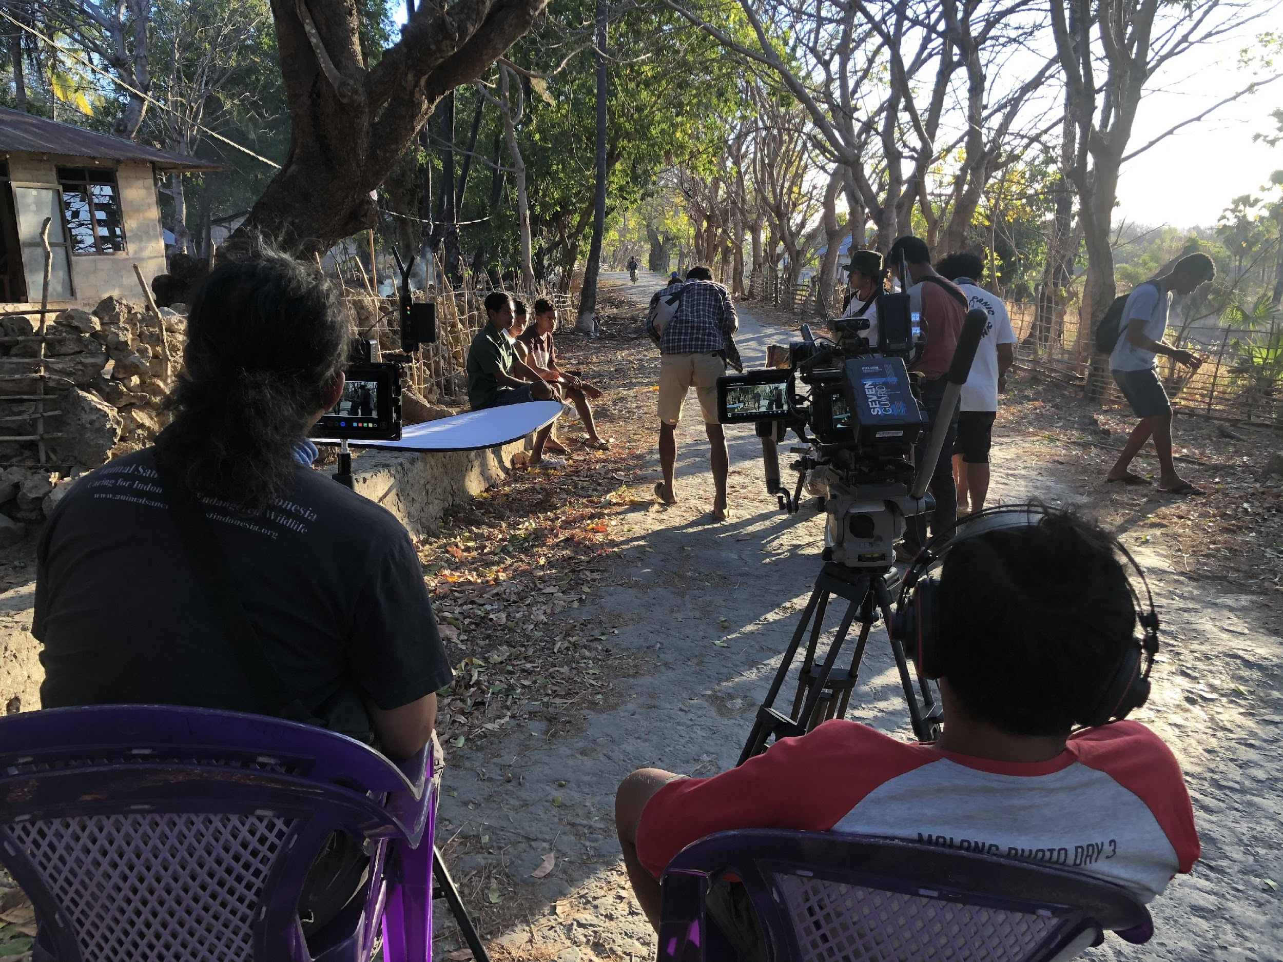
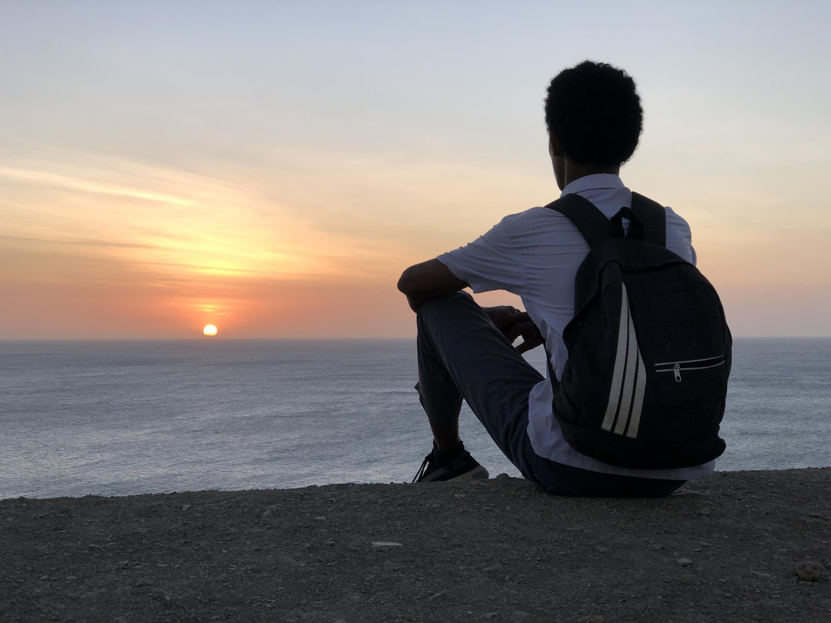
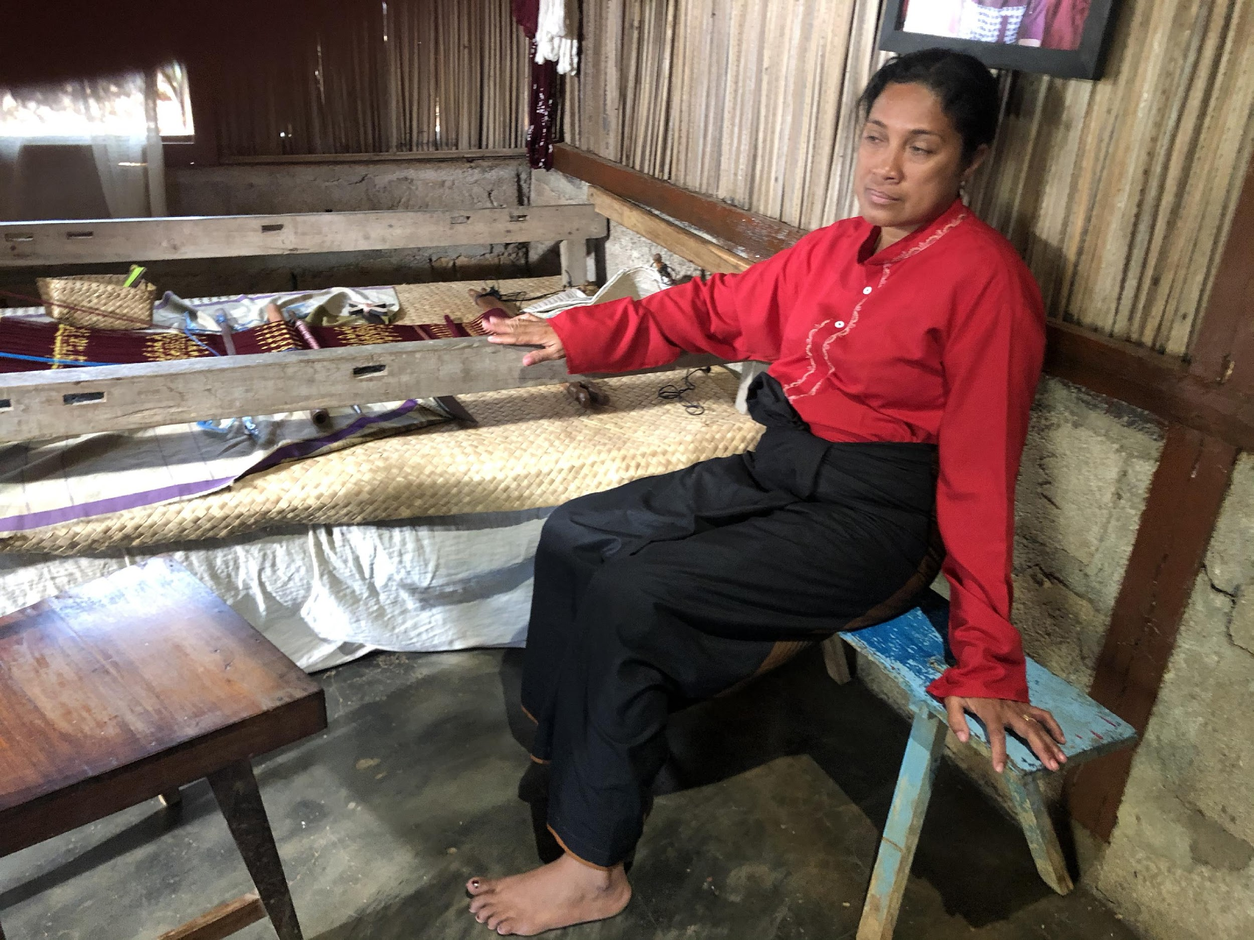
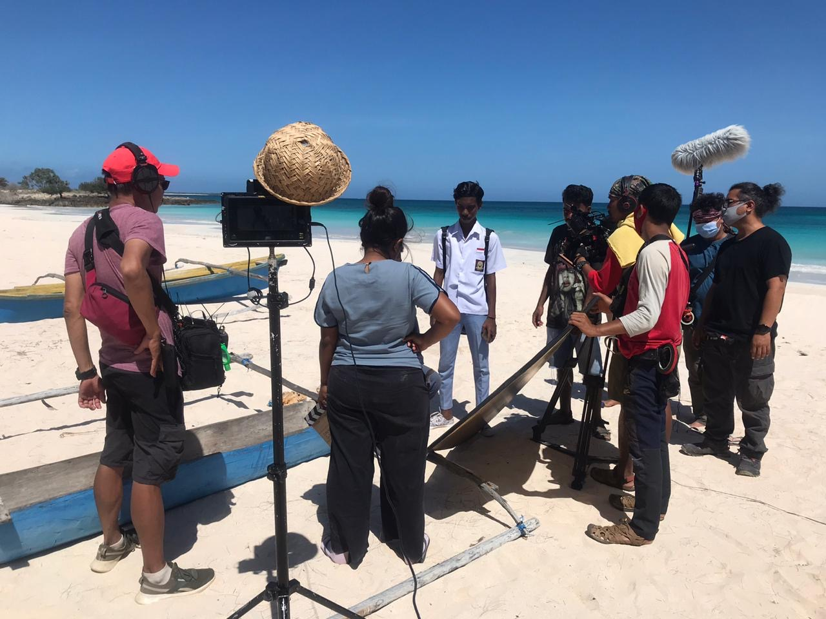
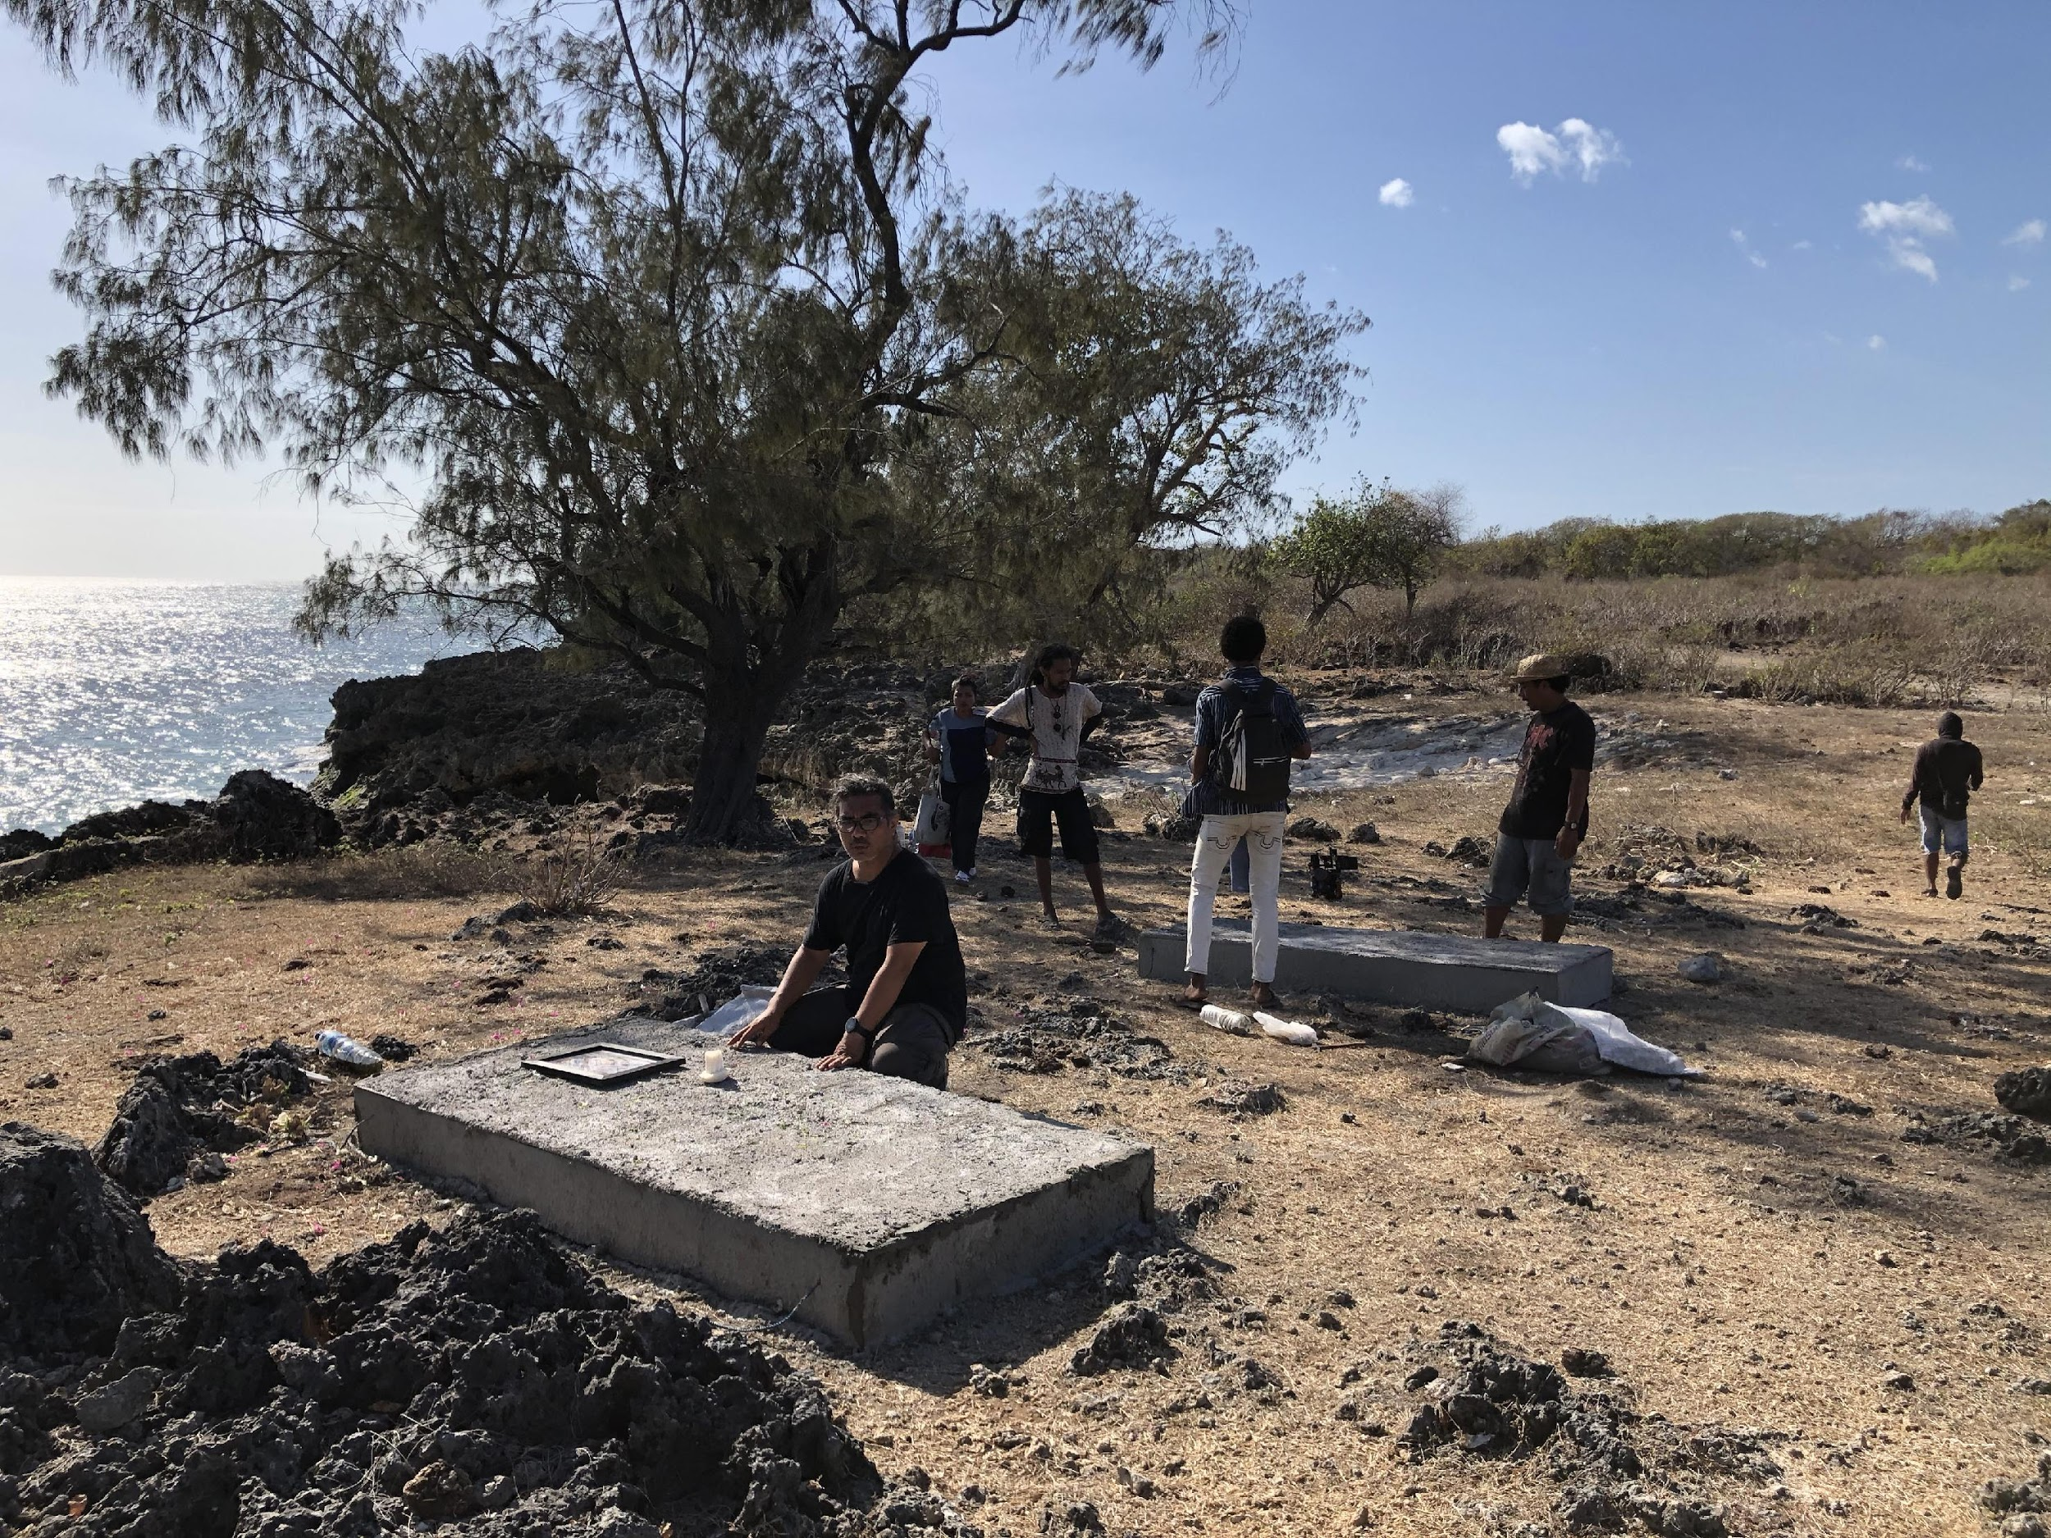
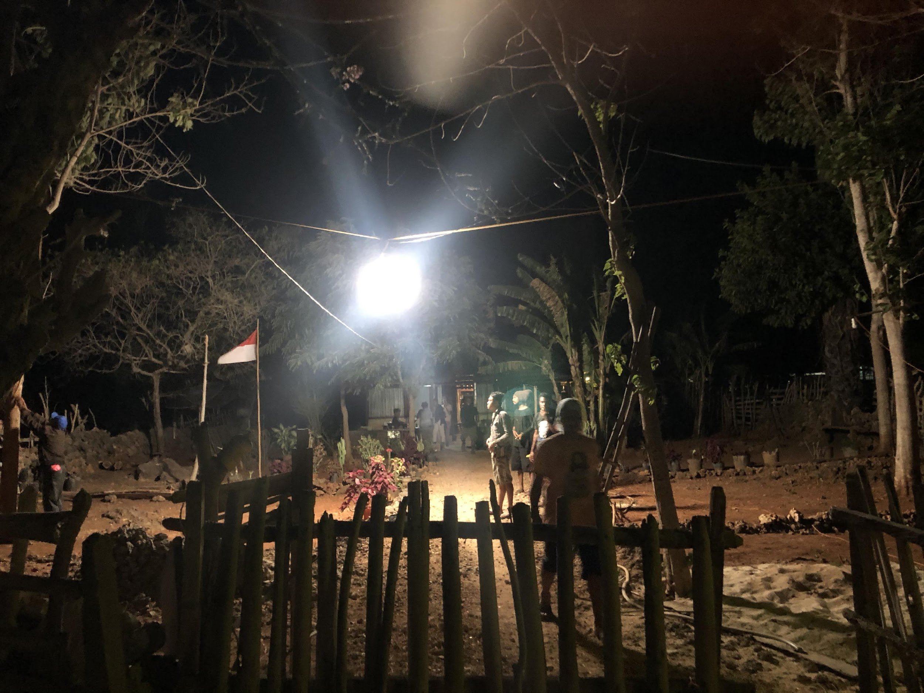
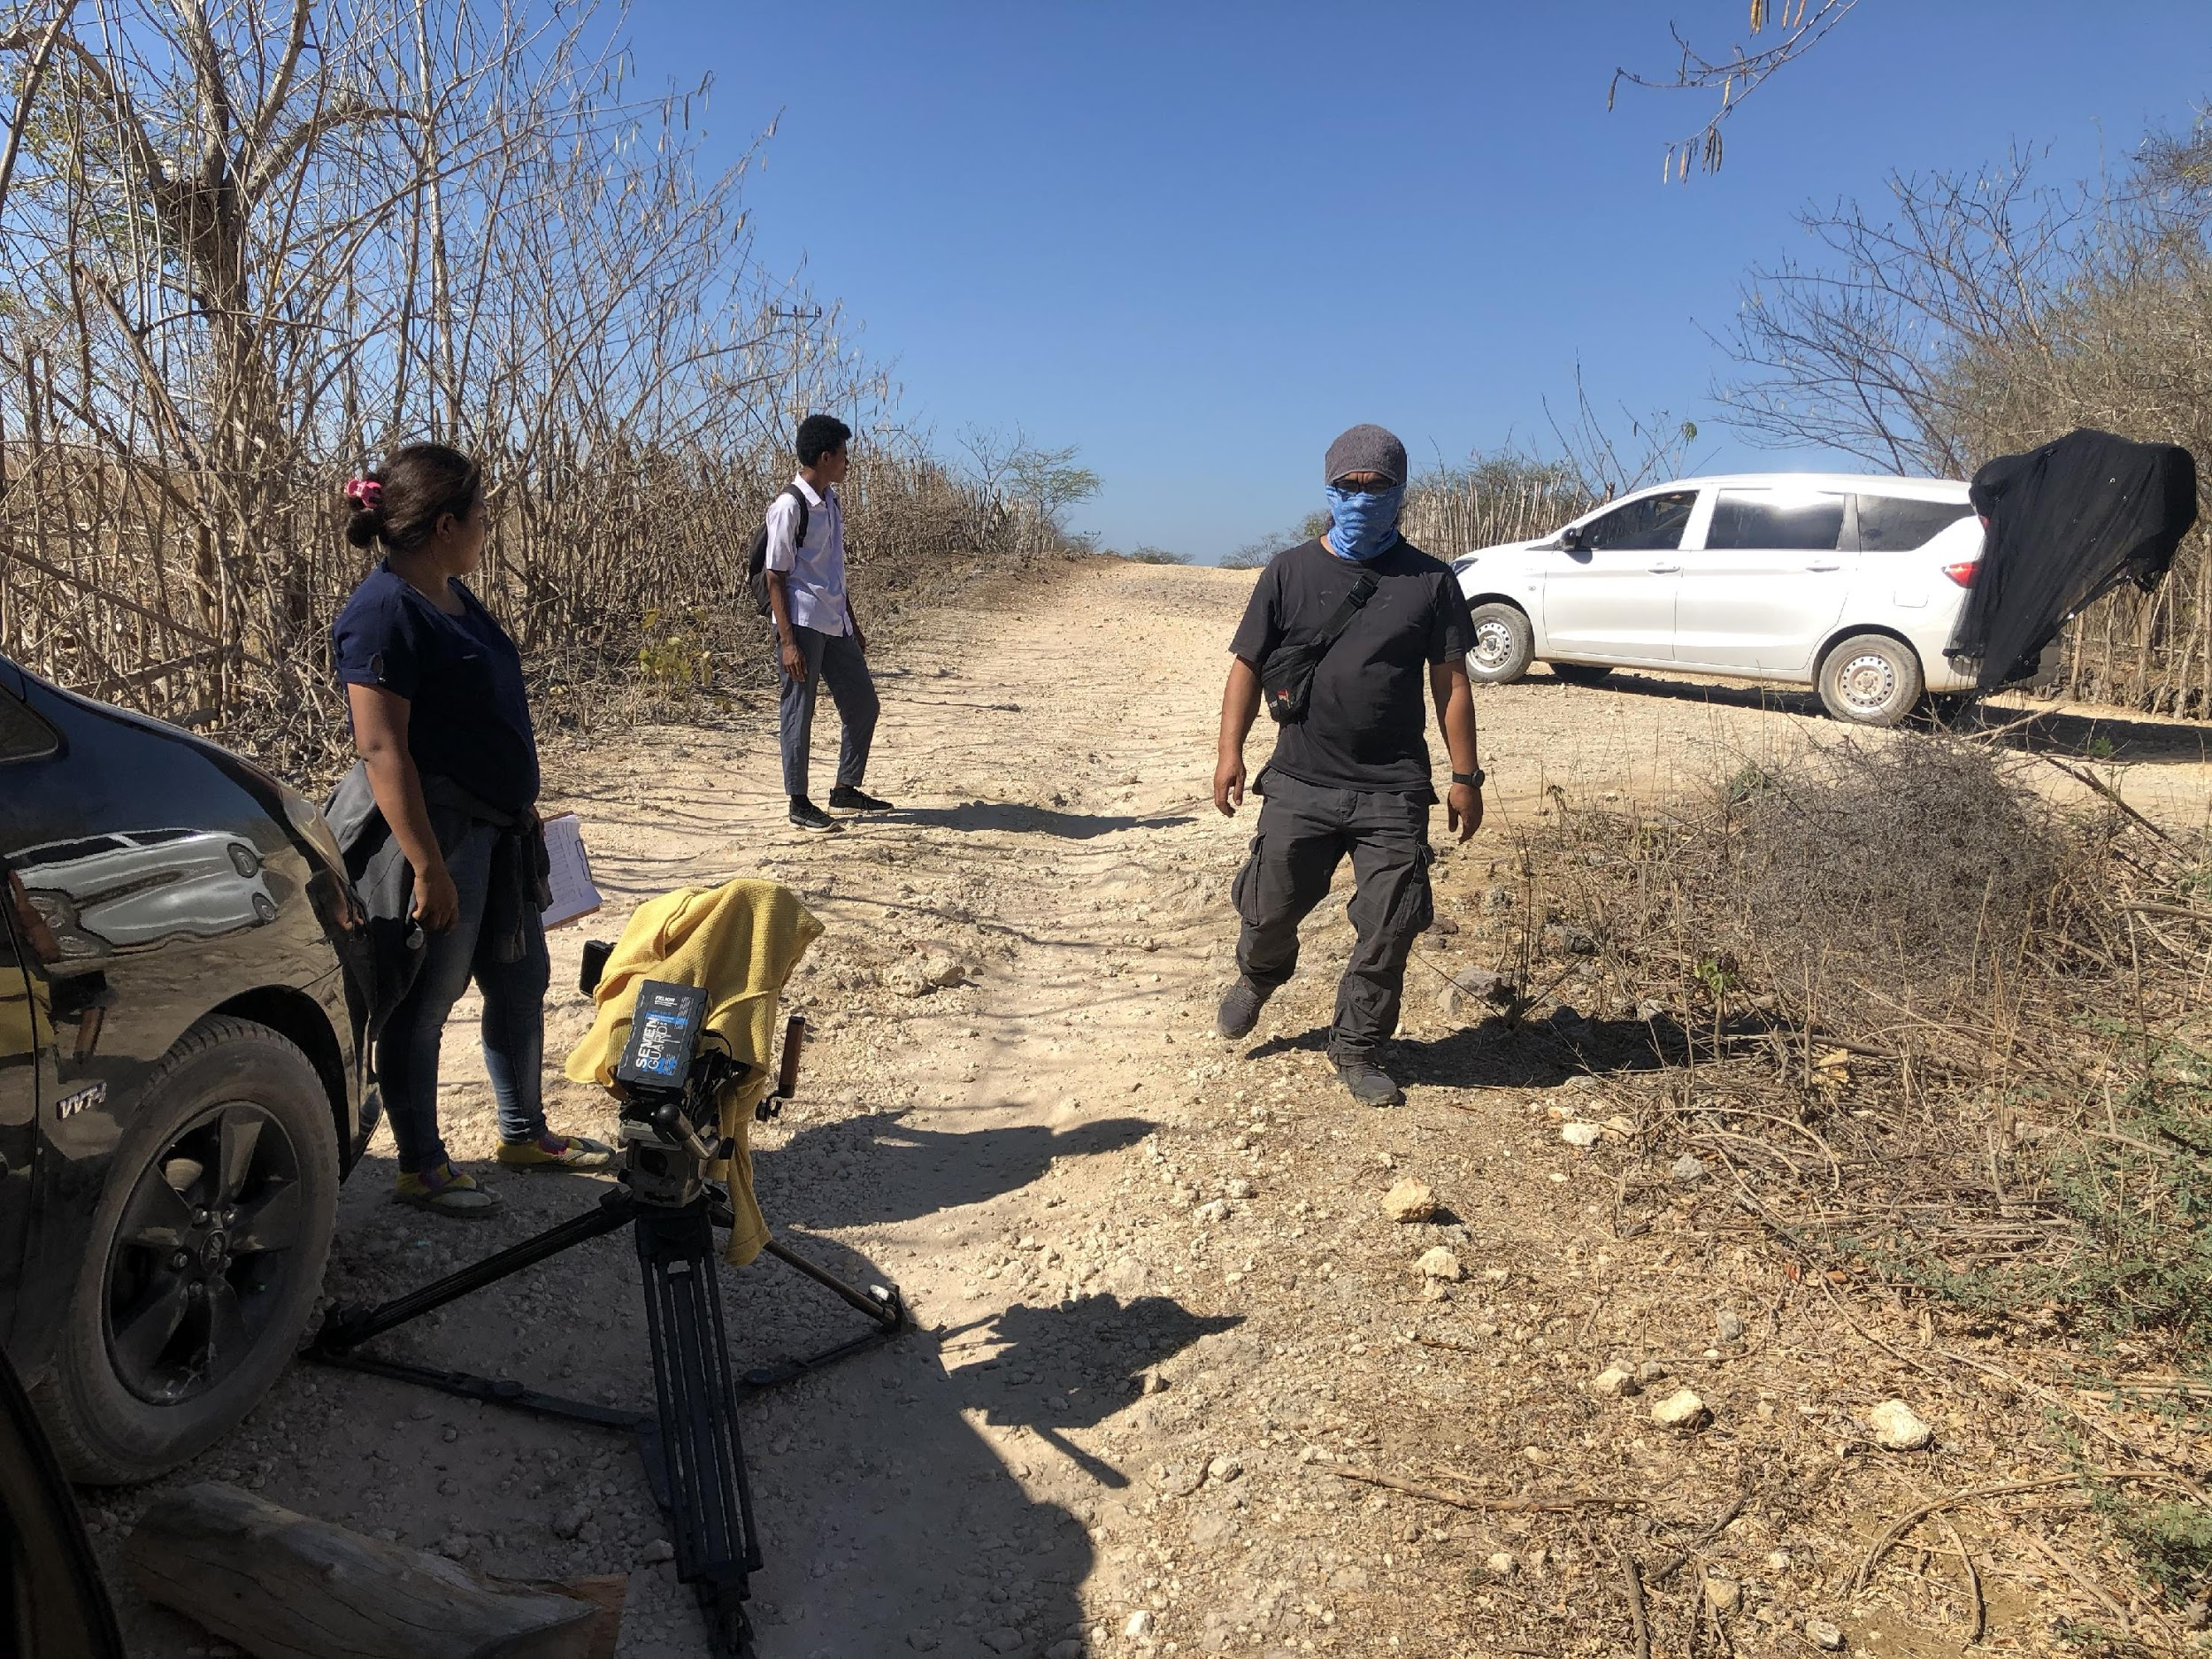
BEHIND THE SCENE

Slide 9
DIRECTOR’S BIOGRAPHY
Born in Jakarta in 1974, Arie Oramahi began his journey in the audiovisual industry in 2004 at a production house for commercials in Jakarta. In 2008, Arie founded his own production house. He produced various commercials and documentaries himself and got involved in many international productions. His involvement in narrative films began as a producer of an independent short film titled Good Boys Go To Heaven in 2016.
In 2019, Arie took part as assistant director in a feature film production collaboration between the Netherlands, Belgium, and Indonesia. In the same year, Arie also acted as assistant director in a drama series production, currently published on an OTT platform in Indonesia.
In 2020, during the Covid19 pandemic, prior to directing Sejengkal, Arie directed a short film titled Rumah (Home), where the whole production process happened while all crew stayed at home.
Arie Oramahi

Slide 10
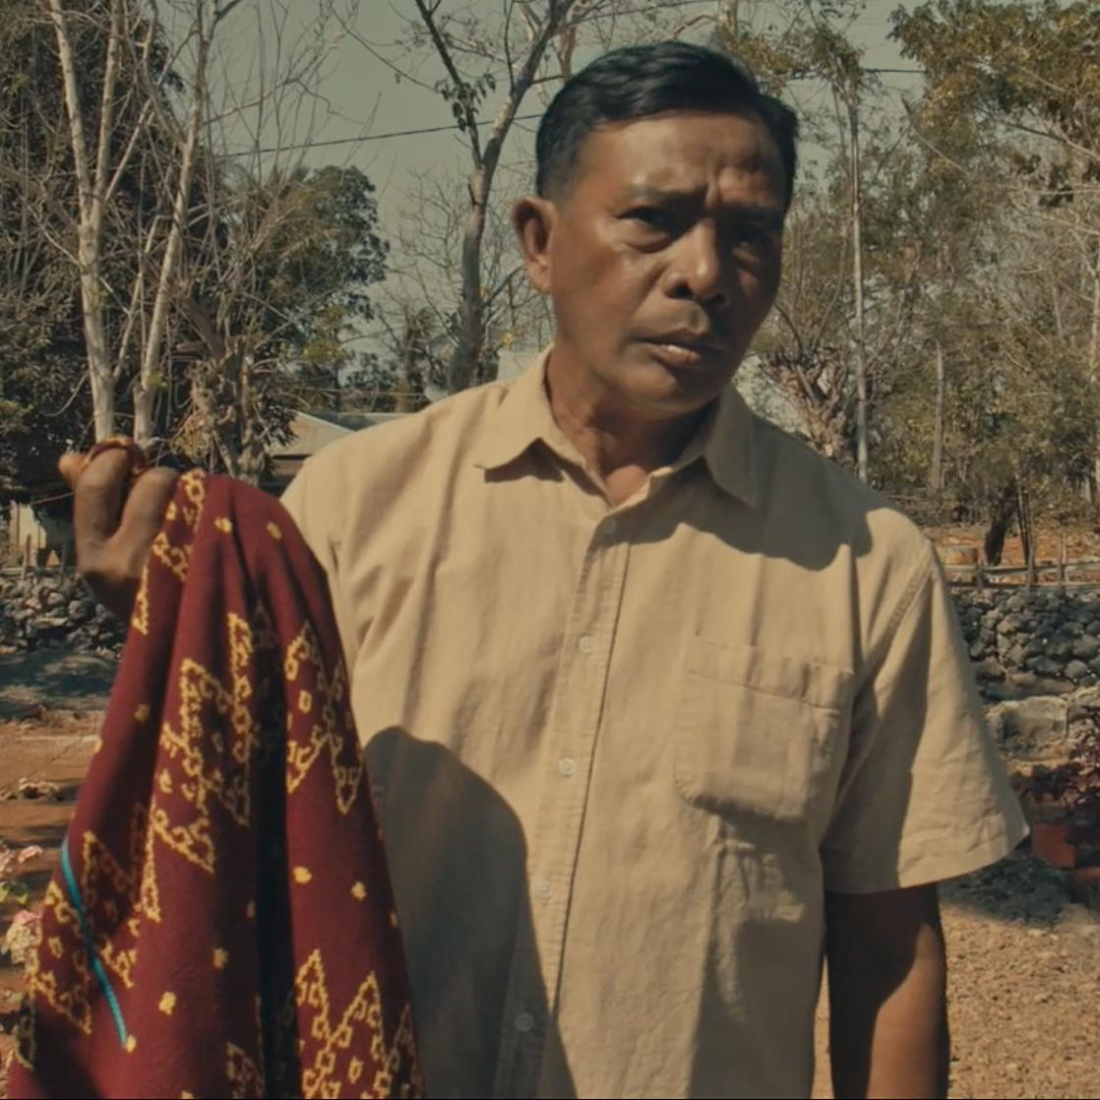
CAST’S BIOGRAPHY
MENAS
Dionisius Rivaldo Moruk, a freshman at Nusa Cendana University.
Born on 1 December 2002, he got interested and participated in art in 2015. He was involved in a film titled “Aisyah Biarkan Kami Bersaudara”, directed by Herwin Novianto. The film garnered various nominations for him in the category of best child actor at FFI and FFB. He won the Maya award in the same category. He also was involved in a theatrical performance for National Christmas 2015 at East Nusa Tenggara.
“I am attracted to this film (Sejengkal) because I love art and culture, moreover I can be involved in the effort of cultural preservation."
ALFRED
Semaya Thomas Katu, born in Kupang, 18 September 1970.
Thomas spends his day working at the farm. He also acts as the chairman of Uiasa village dance studio and a member of the local indigenous committee. Thomas Katu was also the head of his family, or in the local language, Kaka Ama.
He got interested in this film because he believes that the woven cloth tradition of Semau needs to be preserved.

Slide 11
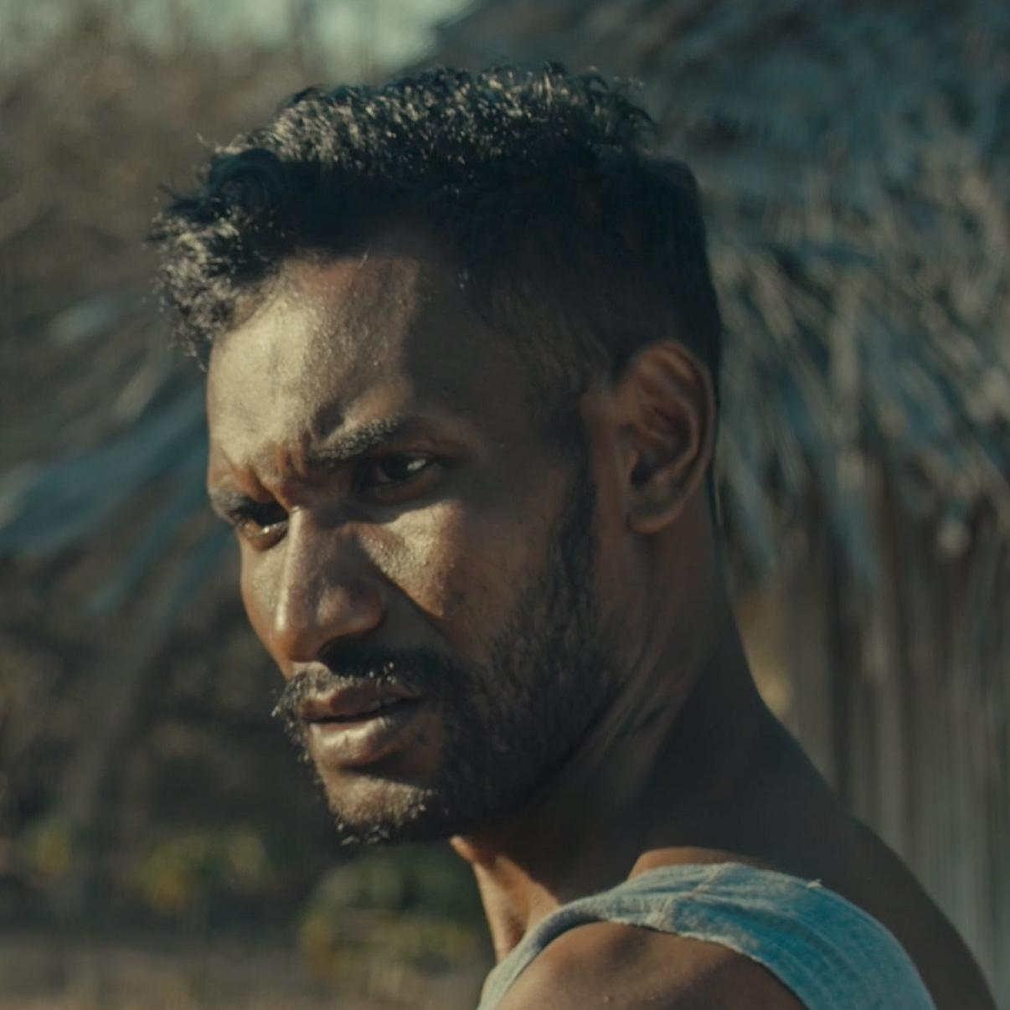
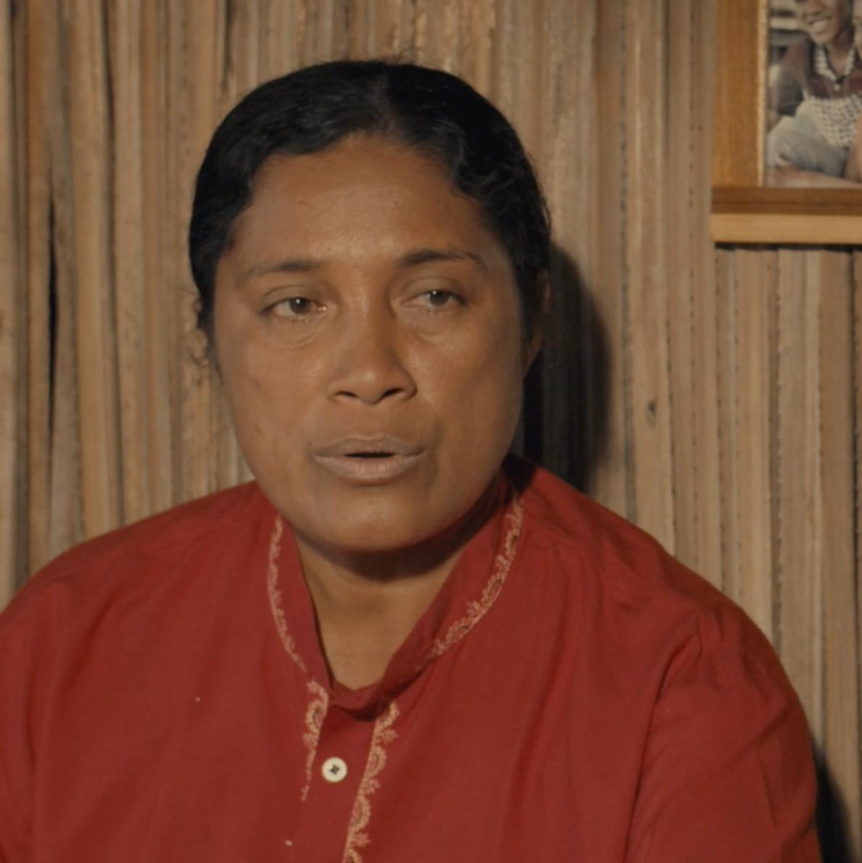
CAST’S BIOGRAPHY
MANU
Zadrak Obaja Nenu, born in Alor 28 May 1995.
Zadrak graduated from the Husbandry major of Nusa Cendana Kupang University. His social work as the field officer at the Geng Motor Imut NGO brings him closer to the people of Semau. His beautiful voice also brought him to various student choir national competitions.
This film marked his first acting experience. He was challenged to try the art, and he also supports the idea that woven cloth supposed to be own by both men and women, for the sake of preserving the tradition in East Nusa Tenggara.
MAMA ESTER
Yeti Katu, lborn in Uiasa, Semau island, 27 October 1979.
Yeti is a homemaker with 4 children. She loves and participates in art since 1997. She's also involved in various art projects in 1999 and 2001.
“I joined this film because I love art and I want to take part in the preservation of our culture in East Nusa Tenggara, through the story of Sejengkal”.

Slide 12
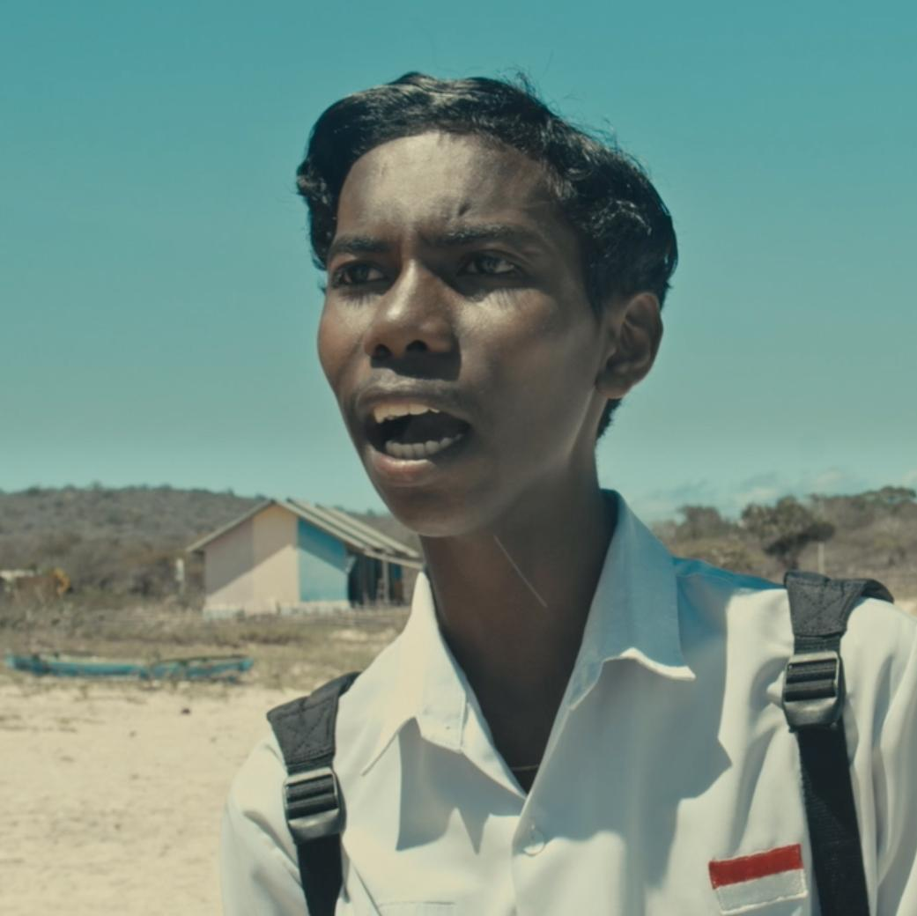
CAST’S BIOGRAPHY
ROSI
Velda Ariance Samenel, born in Oeltua, 9 February 1997.
Velda is a student of Church Music at IAKN Kupang. The world of performance is not a new world for her because she's always been active in her college's theatre stage and joined singing and dancing competitions in the church of Kupang, East Nusa Tenggara.
Velda was happy to join in this film because she got a new skill, which is acting. Moreover, she thinks that it's important to preserve the woven cloth in East Nusa Tenggara regardless of the genders.
DION
Dejan Djenlau, born in Kupang, 20 August 2002.
Dejan is a freshman at Artha Wacana University. He began to participate and like the world of art in 2015. He joined Dion in the film production of “Aisyah Biarkan Kami Bersaudara” by Herwin Novianto. He was also involved in the Dan pernah juga terlibat dalam National Christmas in East Nusa Tenggara in 2015-2017.
“Sejengkal is my vehicle to develop my interest in art, and also to support the preservation of woven cloth in East Nusa Tenggara."

Slide 13
Director
Arie Oramahi
Executive Producer
Catharina Dwihastarini
Producer
Robertus Wahyu Dewanto, Arie Oramahi,
Santirta Martendano
Story by
Catharina Dwihastarini
Scriptwriter
Santirta Martendano
Arie Oramahi
Director of Photography
Santirta Martendano
Art Director
Rexi I.J. Saleh Adu
Editor
Deka Vivedru
Assistant Director
Robertus Wahyu Dewanto
Sound Recordist
Tommy R.V. Lesar
Sound Designer
Novrianto T. Mahendra
Music Composer
Anggi Novalga
Casting
Agusto Ronald Hari Dominggo Bunga
STARRING
TIM PRODUKSI
LAGU RINDU
Menas Dionisius Rivaldo Moruk
Alfred Semaya Thomas Katu
Manu Zadrak Obaja Nenu
Rosi Velda Ariance Samenel
Ester Sufyeti S. Katu Dion Dejan Djenlau
Local Coordinator Agusto Ronald Hari Dominggo Bunga
Assistant to Local Coordinator Arry Pelokilla
Production Assistant Zadrak Obaja Nenu
Wardrobe Ina Duan
Makeup artist Since Katu
Boom Operator Reza Feriyanto
Clapper Kartika Cahya Kurnia Lay
Gaffer Ricky
Assistant Gaffer Rizal Ukat
Genset Operator Yohan D. Killa
Art Department Bonsar K. A. Blegur
Assistant Editor Abung
Visual Effect Nino Imatra
Colorist Sandy Rorimpandey
Driver Putra
Urgenes Laitabun
Poster Designer Johan Tambunan
Translator M. Qashiratu Taqarrabie
Composer : Robertus Wahyu Dewanto
Singer : Michael Felisianus & Amelia Anjani
Arrangement : Anggi Novalga
EXTRAS
Widow Marthen Dominggus Solet
The Deceased Frida Katu
Mourner 1 Berto Susang
Mourner 2 Adryana Pulli
Mourner 3 Katsia Laitabun
Mourner 4 Juliana Kese
Mourner 5 Get Susang
Civilians 1 Matias Bissilisin
Civilians 2 Bonsar K.A. Blegur
Friend of Dion 1 Efendi Laitabun
Friend of Dion 2 Rivaldi Pong

Slide 14
THANK YOU
GEF SGP Indonesia – Terasmitra
Meinar Sapto Wulan Zainal Arifin
Dwi Lestari Rahardiani Y Purwanto
Hery Budiarto Ikatri Meynar Sihombing
Laksmi Dhewanthi Mathias Ola
Julia Kalmirah Yani Witjaksono
Martha Tilaar Adinindyah Arya Wisnutama
Heru Wardhana Dicky Lopulalan
Fransiskus Welirang Wiraswasti Yuliani
Soegiono Dharmatjipto Fitria Werdiningsih
Latipah Hendarti Revi Bestari
Brigita Isworo Anton Sri Probiyantono
Agus Prabowo Brigitta Dewanti
Dominggus Liman Kepala Desa Utitiutuan
Keluarga Bapak Matias Bissilisin, Keluarga Bapak Marthen Dominggus Solet, Keluarga Bapak Sam Lasi, Keluarga Bapak Calvin Masa, Keluarga Bapak Permenas Pully, Keluarga Bapak Abimelek Lote, Keluarga Bapak Eratus Batu
Seluruh Warga Desa Utitiutuan, Pulau Semau , Kabupaten Kupang NTT
YAYASAN PIKUL
Pantoro Tri Kuswardono
Adriana Nomleni
SUPPORTED BY
PT Martina Bertho TBK
PT Bogasari Flour Mills

Slide 15
CONTACT
PRODUCER
Robertus Wahyu Dewanto
robbywahyu@motioncapture.id
+62 821 81506058
Address
Jl G no 79 Srengseng Kembangan Jakarta Barat 11630
Indonesia
DIRECTOR
Muhammad Ariyansyah Oramahi
arieoramahi@motioncapture.id
+62 816 1987934
Address
Puri Primacom Residence Blok C1A Cinangka Sawangan Depok 16516
Jawa Barat - Indonesia
TERASMITRA
Meinar Sapto
terasmitraconnect@gmail.com
+62 856 7341 172
Address
Jl Bacang II No.8 Kramat Pela Kebayoran Baru Jakarta Selatan 12130
Indonesia
GEF SGP Indonesia
Catharina Dwihastarini
dwihastarini@sgp-indonesia.org
+62 815 11034358
Address
Jl Bacang II No.8 Kramat Pela Kebayoran Baru Jakarta Selatan 12130
Indonesia
C A P T U R E

Slide 16
sejengkalmovie
sejengkalmovie@gmail.com

